Slide 1
Script Code Explanation

Slide 2
01_convert_annotations.py
This file converts the human annotator’s Word document into a structured CSV file. It opens the .docx file like a ZIP archive, reads its internal XML, and finds the table beginning with “Start Time.” For every annotation row, it extracts the event’s start time, end time, type, involved objects, severity, near-miss status, and notes. Timestamps such as 3.09 are converted into seconds, so 3.09 becomes 189 seconds. A severity value means the event is treated as a collision. Finally, the events are sorted by time and saved as data/ground_truth.csv for later scripts.

Slide 3
2. 02_extract_features.py
This is a very important file. It takes your video.mp4 and YOLO segmentation model and checks the video frame by frame. YOLO tries to find three things: TIPL, TIPR, and TIPandCircle. From these detections, the code calculates useful information such as the position (x,y), width, height, confidence, area, distance between the two tips, IoU/overlap, and movement speed. It also uses a simple tracker when one tip temporarily disappears because the two tips may overlap during a collision. Then it compares each video's timestamp with ground_truth.csv and gives each frame a label: 0 = no collision, 1 = collision. Finally, everything is saved into features_and_labels.csv.

Slide 4
3. 03_train_classifier.py
This file takes features_and_labels.csv and trains an XGBoost classifier. The model learns the relationship between things like tip distance, movement speed, overlap, mask area, etc. and the collision label. Instead of using just one train/test split, your code uses StratifiedGroupKFold, which divides nearby frames into groups so that frames from the same short event don't get incorrectly separated between training and testing. It then generates probabilities such as 0.20, 0.60, or 0.90, where a higher probability means the model thinks collision is more likely. The code also selects a decision threshold and finally trains a model using all available data

Slide 5
4. 04_evaluate.py
After training, this file evaluates the predictions produced by the classifier. It calculates important metrics such as Accuracy, Precision, Recall, F1-score, ROC-AUC, and Average Precision. It also creates a confusion matrix, which tells you how many frames were correctly classified and how many were wrong. The code generates visual charts including the confusion matrix, ROC curve, Precision-Recall curve, and feature-importance chart. These results help you understand whether your collision detector is performing well or producing too many false alarms

Slide 6
5. 05_visualize_detections.py
This file is mainly for visual checking. It opens your video and runs the YOLO model on sampled frames. Then it draws bounding boxes and labels around the detected objects, such as TIPL, TIPR, and TIPandCircle. You can actually watch what YOLO thinks it is detecting. This is useful because sometimes the model may incorrectly detect something or lose a tip during a collision. You can pause/resume the video with Space, move one sampled frame using N, and quit using Q or Esc.

Slide 7
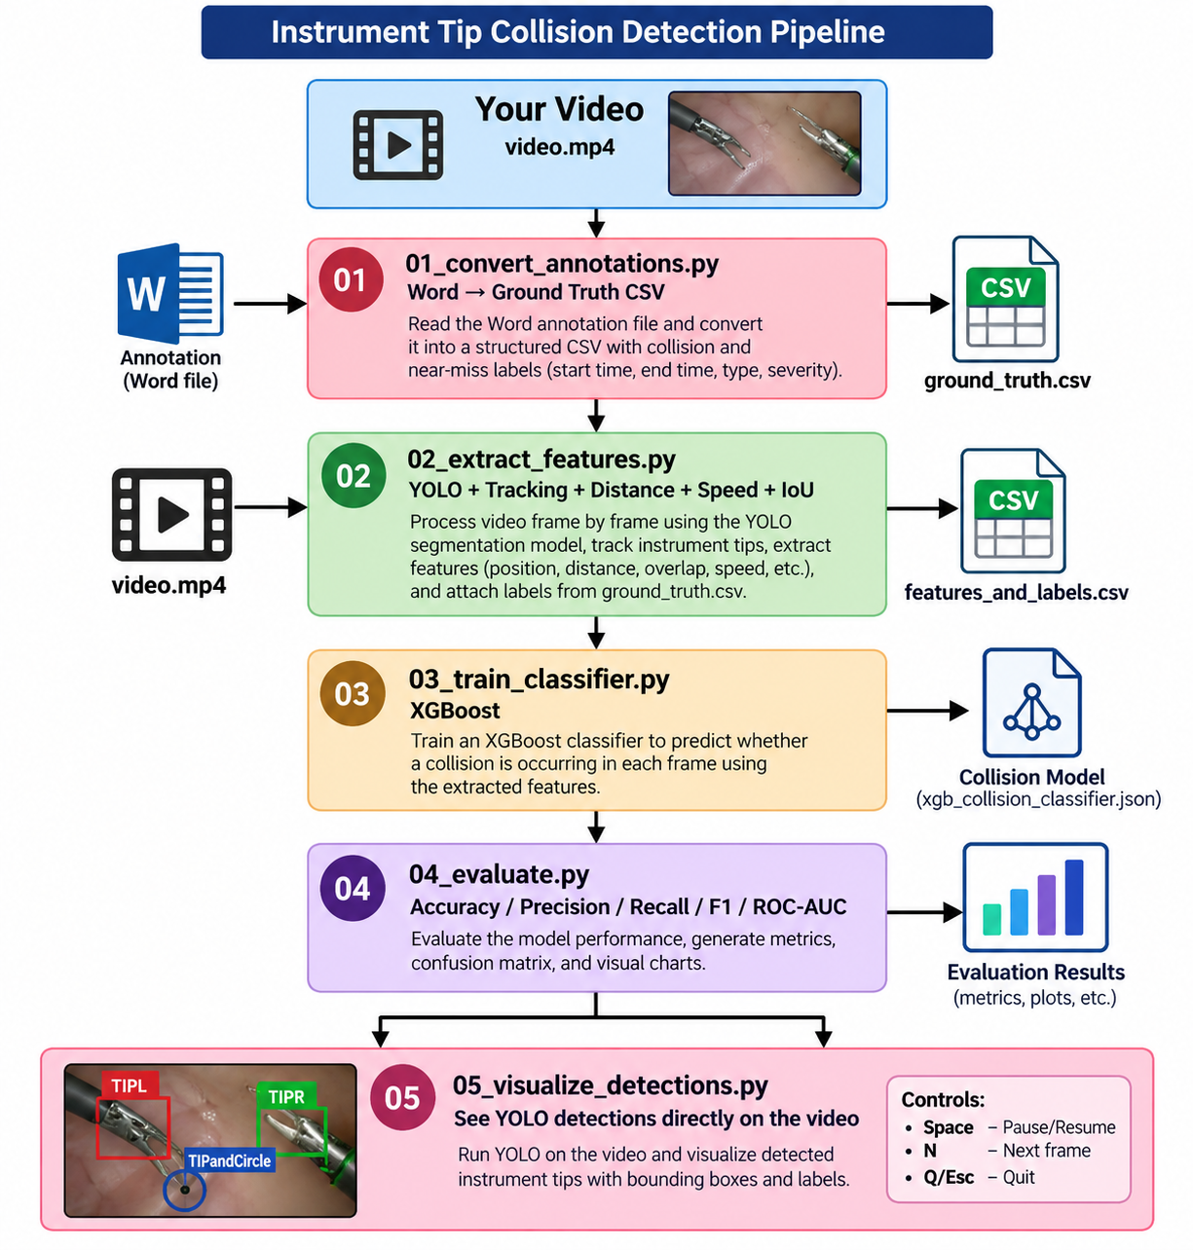
Full Pipeline

